Slide 1


PulseMAX Building a ESP8266 NodeMCU based MAX30102 Pulse oximeter webserver
GROUP 6, ETC, 6TH SEM

Slide 2
CONTENTS
Introduction
Design and Implementation
Performance Evaluation
Applications
Challenges and Future Work
Conclusion

Slide 3
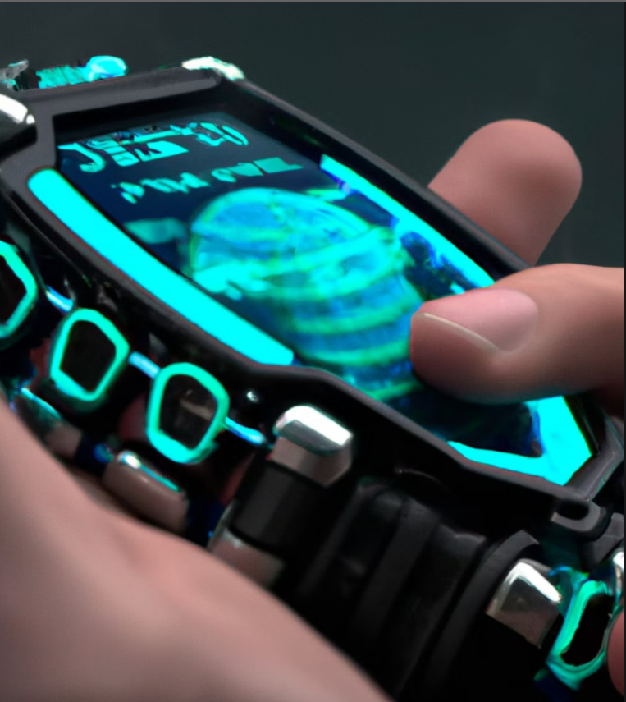
INTRODUCTION
The pulse oximeter is a medical device that measures the oxygen saturation in the blood. It is an essential tool for monitoring patients with respiratory or cardiovascular diseases. In this project, we have developed a pulse oximeter using MAX30102 and ESP8266 NodeMCU.
The MAX30102 is a highly integrated pulse oximeter and heart-rate sensor chip. It has an integrated red LED and infrared LED, photodetector, and low-noise amplifier. The ESP8266 NodeMCU is a Wi-Fi enabled microcontroller board based on the ESP8266 chip. It provides a platform for developing IoT applications.

Slide 4
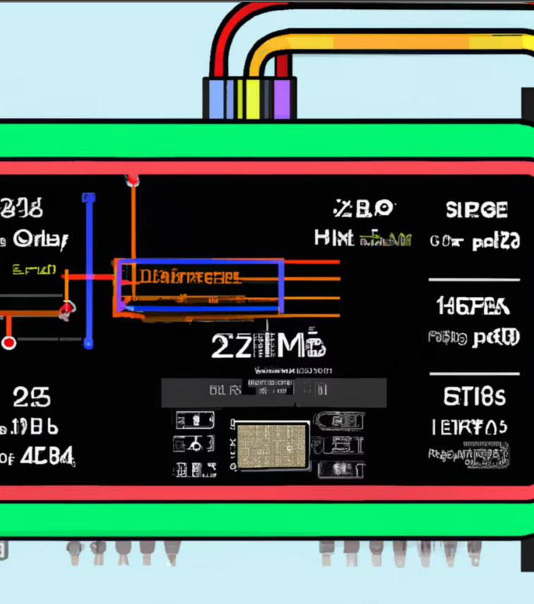
DESIGN AND IMPLEMENTATION
The pulse oximeter circuit consists of the MAX30102 sensor, ESP8266 NodeMCU, and result display screen in RemoteXY. The MAX30102 sensor is connected to the ESP8266 NodeMCU through the I2C interface. We have used the Arduino IDE to program the ESP8266 NodeMCU.
The firmware for the pulse oximeter is written on Arduino IDE. It uses the MAX30102 library to read the raw data from the sensor. The raw data is then processed to calculate the oxygen saturation level and heart rate. The results are displayed on in real-time display screen . The pulse oximeter also sends the data to a cloud server using the Wi-Fi connection.

Slide 5
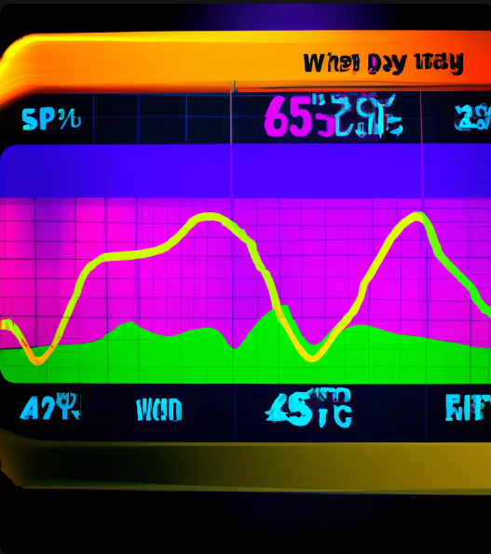
PERFORMANCE EVALUATION
We have tested the pulse oximeter using a healthy volunteer. The results show that the pulse oximeter can accurately measure the oxygen saturation level and heart rate. The measurements were compared with a commercial pulse oximeter, and the results were consistent.
The pulse oximeter also has a low power consumption. The Wi-Fi connection also works reliably, and the data can be accessed from anywhere in the world.

Slide 6
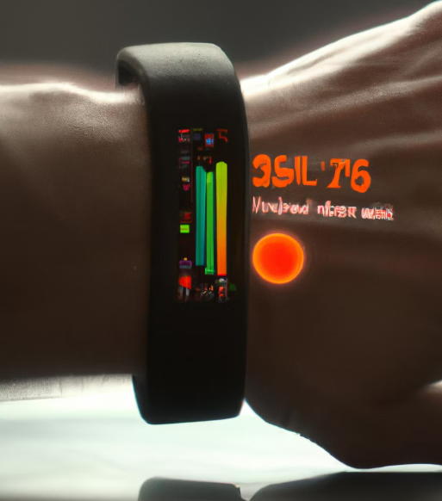
APPLICATIONS
The pulse oximeter can be used in various medical applications, such as monitoring patients with respiratory or cardiovascular diseases. It can also be used in sports science to monitor athletes' performance and recovery. The pulse oximeter can also be used in home healthcare to monitor the health of elderly or chronically ill patients.
The pulse oximeter can be further improved by adding more sensors, such as temperature and humidity sensors, to provide a complete health monitoring system. The data can be analyzed using machine learning algorithms to provide personalized health recommendations.

Slide 7

CHALLENGES AND FUTURE WORK
One of the challenges we faced during the project was optimizing the firmware for the ESP8266 NodeMCU. The limited memory and processing power of the microcontroller made it challenging to implement complex algorithms. We also faced challenges in designing the PCB layout and assembling the components.
In the future, we plan to add more sensors to the pulse oximeter and develop machine learning algorithms to analyze the data. We also plan to improve the user interface of the pulse oximeter and make it more user-friendly. We believe that the pulse oximeter has great potential in improving healthcare and sports science.

Slide 8
CONCLUSION
In conclusion, we have developed a pulse oximeter using MAX30102 and ESP8266 NodeMCU. The pulse oximeter is accurate, reliable, and has low power consumption. It has various applications in medical, sports science, and home healthcare. We have also identified areas for improvement and future work.
Overall, the pulse oximeter has great potential in improving healthcare and sports science. We hope that our project will inspire further research and development in this field.

Slide 9
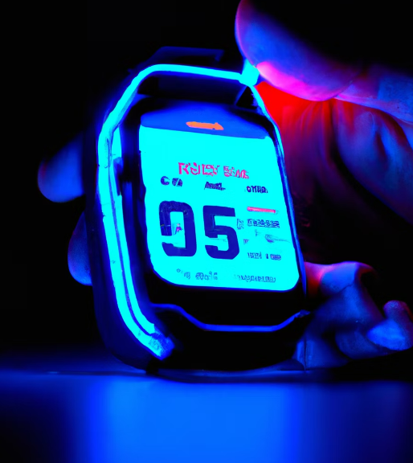
SUBMITTED BY: SUBHASISH MALLICK (B220058) SUBHRA BHANJA(B220059) SUBHRA TRIPATHY (B220060) SUDIP NAYAK(B220061)

